Slide 1
Managerial Economics and Organizational Architecture, 7e Chapter 3:
Exchange and Markets

Slide 2
The Goals of an Economic System
To satisfy human needs and wants
What to produce?
How to produce it?
Who gets it?
The answer depends on the allocation mechanisms,
Free markets
Central planning
2

Slide 3
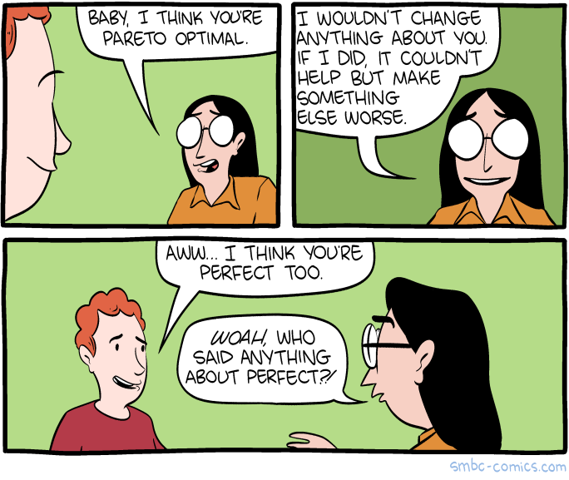
Comparing Effectiveness of Economic Systems; the need for a criteria.
A resource allocation is Pareto efficient if no alternative helps at least one person without harming anyone else!
In free markets, economic decisions are decentralized to individuals
In centrally planned economies, government officials make economic decisions
Kilde: https://www.smbc-comics.com/comic/pareto-romantic
3

Slide 4
Markets, Property Rights and Exchange
A property right (ejendomsret) is a legally enforced right to select the use of an economic good
A property right assigned to a specific person is a private right
Private rights are alienable (afhændelige) in that they can be transferred to another individual, within limits (nyre-ex.)
individuals have use rights within limits
4

Slide 5

Gains From Trade
Individuals trade something they value less for something they value more
Trade creates value
Sources of trade gains
differences in preferences (buyer/seller of auto)
comparative advantage (in auto production – the producer!)
Kilde: https://www.thedailymeal.com/1631476/supermarket-checkout-strategy-easy/
5

Slide 6
Specialization
Individuals specialize in producing goods for which they have a comparative advantage
Comparative advantage occurs when an individual has a lower opportunity cost of producing a good (than another individual)
Specialization and trade make both parties better off
Se s. 69! VIGTIGT, læs selv bemærk, at Donna er absolut bedst til at producere både kød og øl!
Ramme:
P. 68n.
P. 71 n. og
P. 72 m.!
6

Slide 7
Supply and Demand in the PC Industry
$
When prices are high, the quantity supplied is greater than quantity demanded, and a surplus exists.
When prices are low, the quantity demanded is greater than quantity supplied, and a shortage exists.
Only the market-clearing price avoids surpluses or shortages.
Supply
Surplus
P^{HI}
Price (in dollars)
P*
P^{LO}
Shortage
Demand
Q
Q*
’Snapshot’
Quantity of PCs
7

Slide 8
The Nature and Function of Prices; a social coordination mechanism
Prices coordinate consumption and production decisions;
price signals give suppliers incentives to shift production to high priced products
price signals give consumers incentives to reduce quantity of high price products
goods are rationed to those willing to pay
equilibrium; ‘the invisible hand’ (A. Smith)
prices signals, control and coordinate!
8

Slide 9
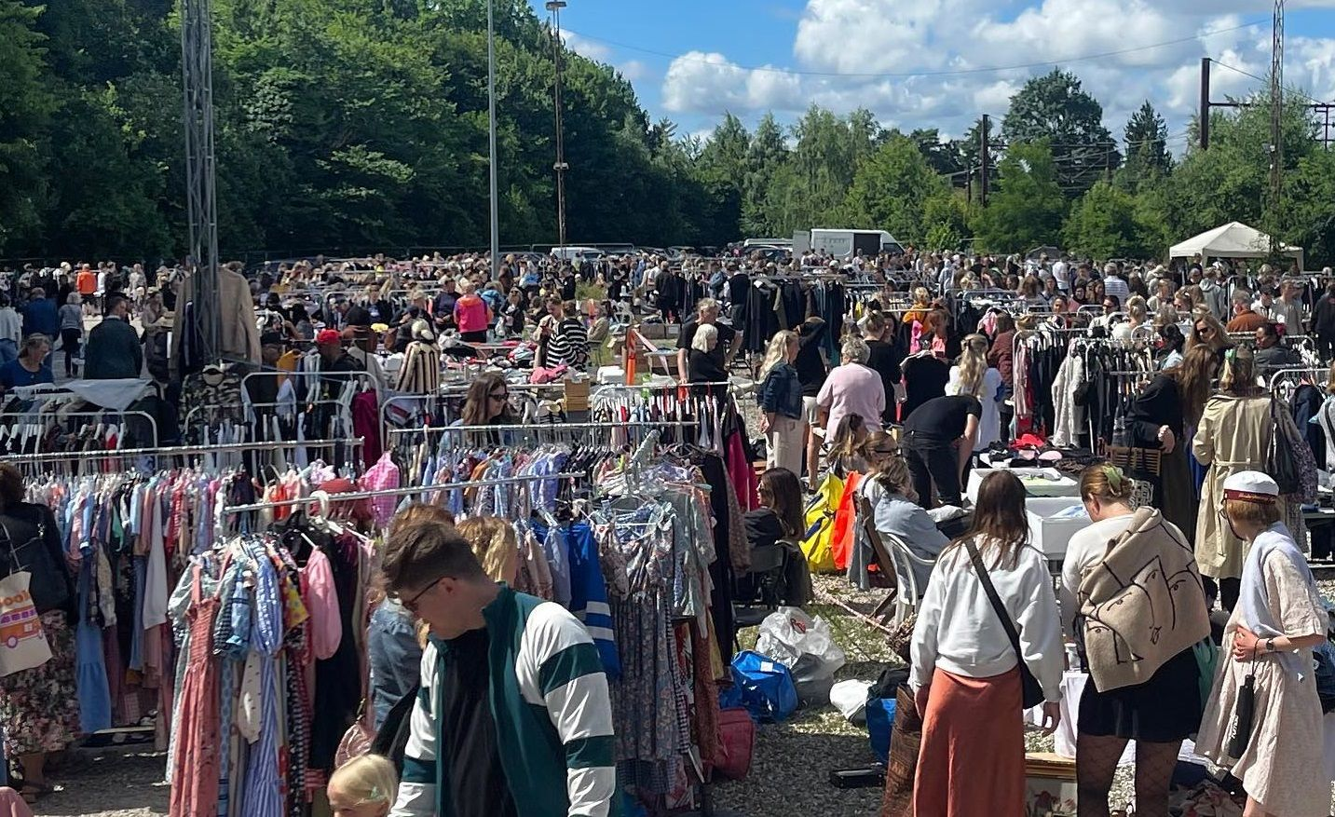

Gains From Trade
Consumer surplus - the difference between what consumers are willing to pay and what they actually pay
measured as the area below the demand curve and above the price
Producer surplus - the difference between the price received and willingness to produce
measured as the area above the supply curve and below the price
Kilde: https://cphpost.dk/2024-11-20/news/environment/over-70-of-people-in-denmark-bought-from-second-hand-shops/
9
Kilde: https://www.howtoliveindenmark.com/moving-to-denmark/denmarks-second-hand-economy/

Slide 10
Consumer and Producer Surplus
P
$20
Consumer surplus
(Triangle A)
Supply
A
$10
Producer surplus
(Triangle B)
S. 14n.,
note 4 igen
B
Incremental production
Costs (Triangle C)
C
Demand
Q
10
10

Slide 11
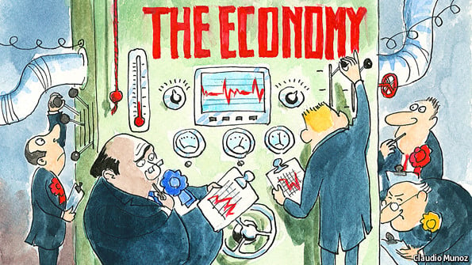
Government Intervention
Consumer and producer surplus can be used to examine the effects of government intervention on gains from trade
Price caps limit the maximum price that can be charged
Price floors are a legally set minimum price at which goods can be traded
Kilde: https://www.economist.com/britain/2013/09/21/the-new-interventionism
11

Slide 12

Government Price Cap on Gasoline
$/Gallon
Supply
Lost gains
from trade
A
$3.00
Excess demand
(shortage) for gasoline
B
C?
$2.00
$2.00 price cap
Demand
Q
12
Q_{S}
Q_{D}

Slide 13
Minimum Wage Laws
Unemployment
(excess supply
of labor)
Labor Supply
$5.15
Minimum Wage
A
$4.00
Lost gains from
trade
B
Labor Demand
Q_{S}
Q*
Q_{D}
13
Quantity of labor

Slide 14

Externalities and the Coase Theorem
Externalities occur when the actions of one party impose a benefit or cost on another party outside the exchange relationship!!!!
Pollution (MR=MC?, noise, graffiti, good music…)
Markets may not be efficient.
(The) Coase (theorem) argue that market exchange will be efficient if:
Property rights can be traded
Transaction (contracting) costs are sufficiently low regardless centralization/decentralization!
Ramme 93 - 95ø.!
ESSENTIELLE SIDER I BOGEN
Kilde: https://www.dreamstime.com/illustration/noisy-neighbor.html
14

Slide 15
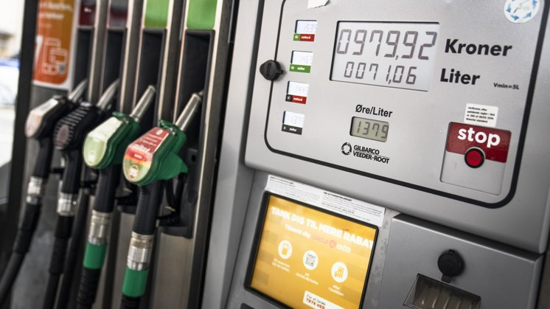

Free Markets versus Central Planning
General knowledge; is freely transferable
Specific knowledge; is expensive to transfer
Centrally planned economies fail because specific knowledge is not used in the planning process
Prices ‘deliver’ general knowledge at low cost (Hayek)
Ramme 99ø. - 100ø.! – Køb/salg af jord, virksomheder mm. jvf. Alice’ og Jamals NPV
General
Kilde: https://nordjyske.dk/nyheder/danmark/nye-regler-kan-goere-det-billigere-at-tanke-benzin-og-diesel/5838809
Specific
Kilde: https://www.shutterstock.com/image-photo/black-female-dentist-examining-small-boys-1963795693?trackingId=ed7242ef-272a-47e2-a248-deb56d02136c&listId=searchResults
15

Slide 16
Specific Knowledge
Examples
complex knowledge of particular circumstances (kontekst, bundet op til tid og sted), fylde lastbil? Pris?
scientific knowledge (DNA-viden, forklar til menigmand!)
assembled knowledge (samlet/akkumuleret viden – revisor)
Free markets make superior use of specific knowledge dispersed among many participants (Hayek); decen-tralization towards where the ‘specific knowledge’ is!
Activities are coordinated by prices. The ‘miracle’ of the price system (verdens 8. vidunder!, Hayek)
16

Slide 17
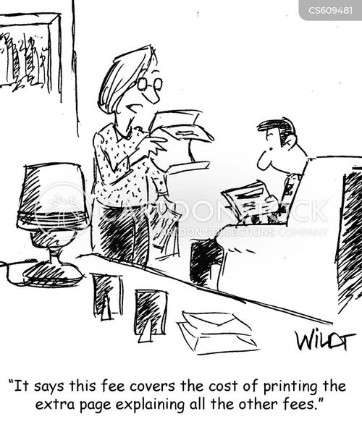
Why do Firms Exist? The role of transaction costs (Williamson)
Types of transaction costs
search and information costs
bargaining and decision costs
policing and enforcement costs
opportunity cost of inefficient resource allocation
Optimal economic organization minimizes transaction costs!
Kilde: https://www.cartoonstock.com/directory/f/fee_surcharges.asp
17

Slide 18
Firms Can Reduce Transaction Costs
Advantages of firms (organization, hierarchies) over markets
fewer transactions
information specialization
reputational concerns/confidence
Organize activities in a/the firm if at lower costs than the market
Why isn’t the economy/a country/the world just one big firm?
18

